Slide 1































Slide 2


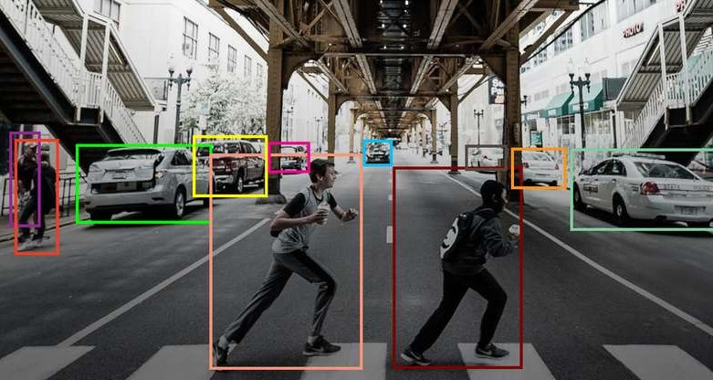



































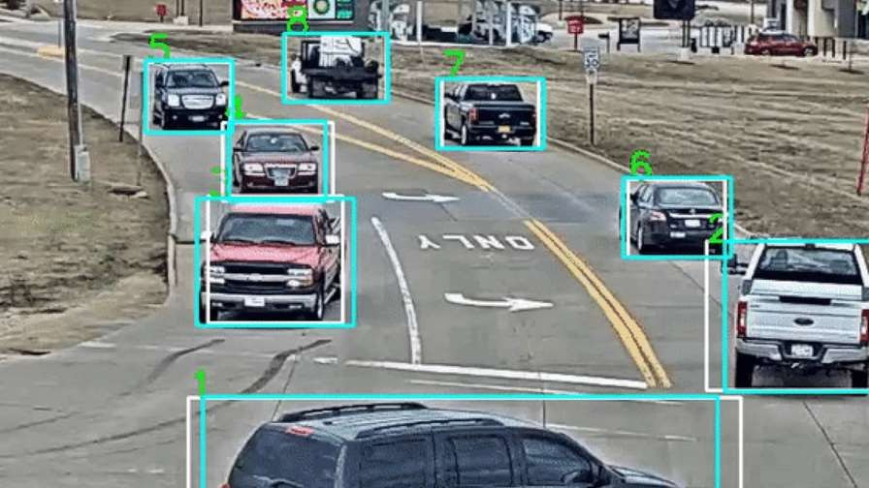


































•
•
•

Slide 3













Slide 4

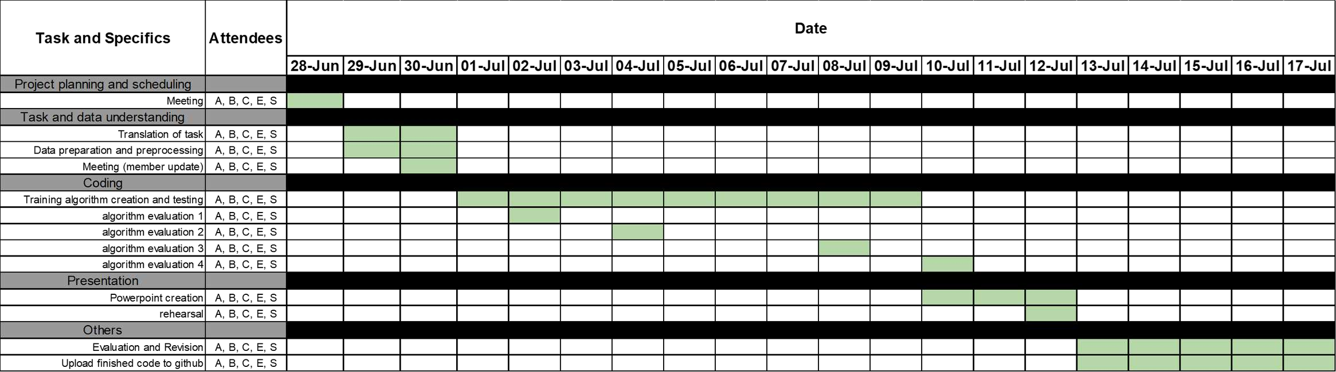
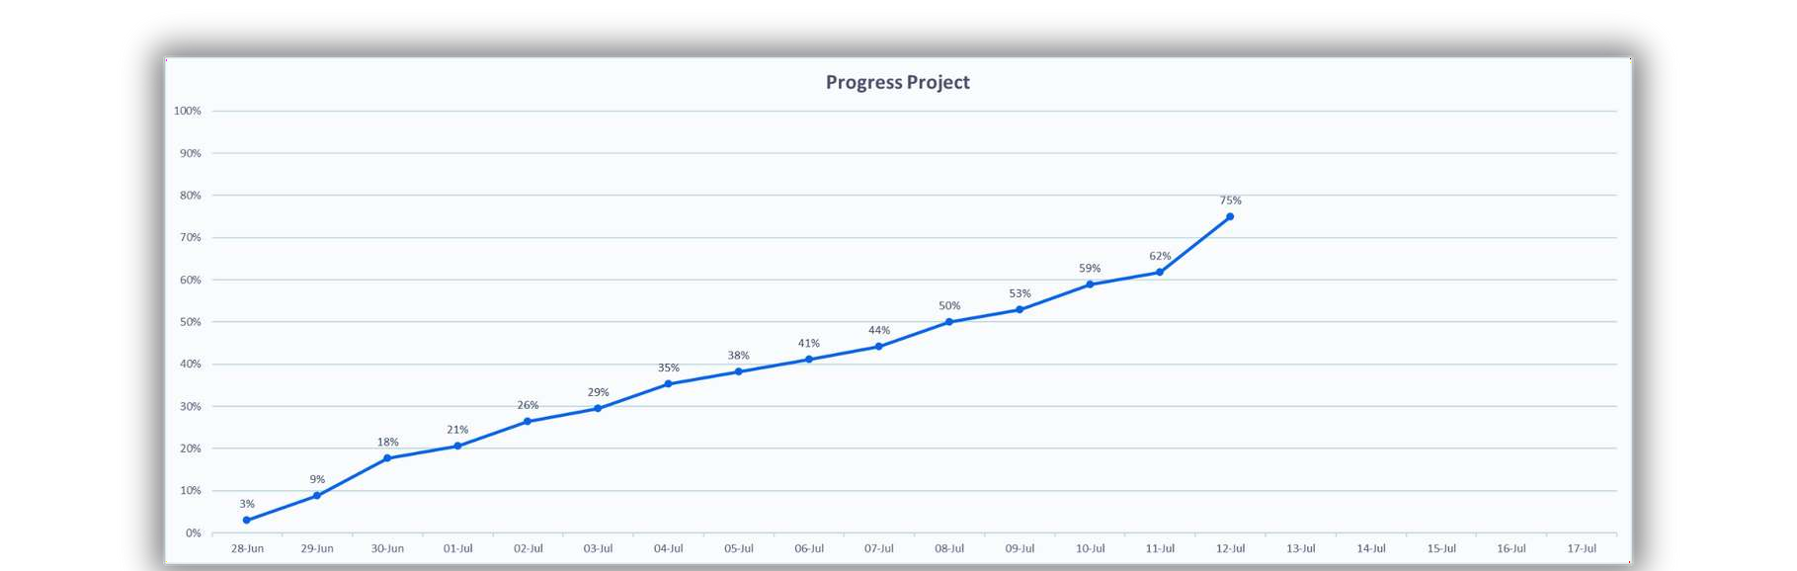

Slide 5



MODEL EVALUATION
BUSINESS & DATA UNDERSTANDIN G
DATA PREPROCESSING
DATA
MODELLING
FASTER RCNN (NOT PURSUED)
YOLO
DATA FILTERING
DATA TRANSFORMATION

Slide 6

































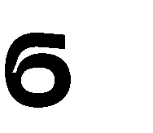


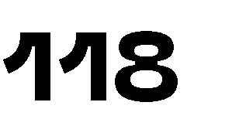


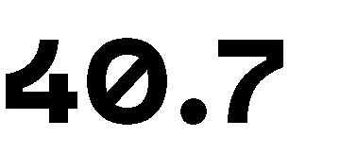


•
•
•
•

Slide 7






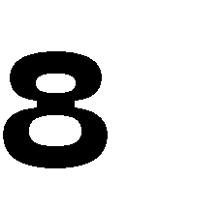





























•
•
•
•
•
◦
◦
•
•
▪
▪
▪

Slide 8







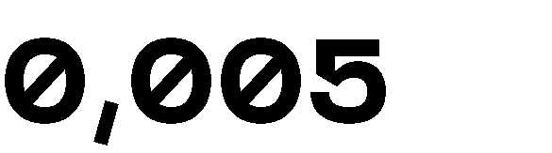
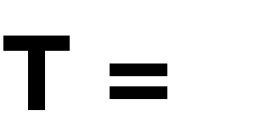
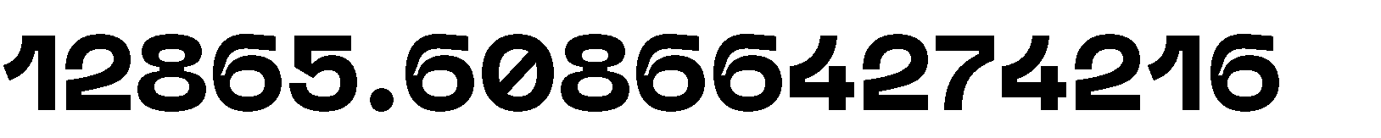

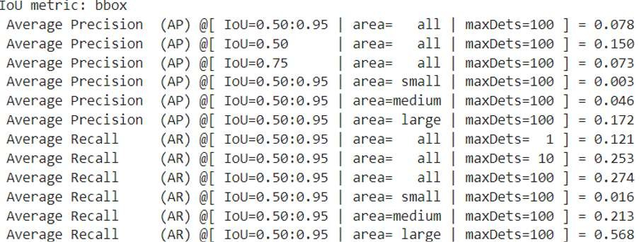















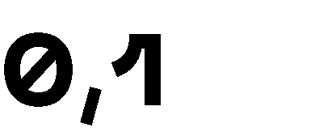
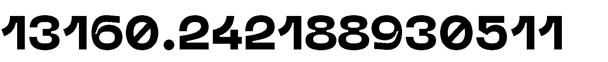



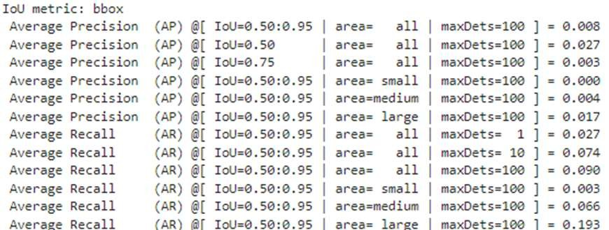






•
•

Slide 9

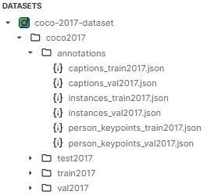

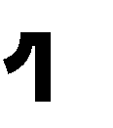







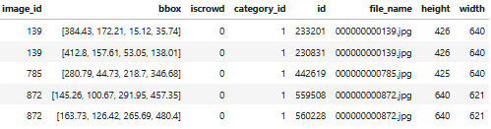

Slide 10
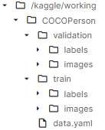
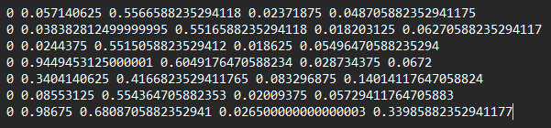




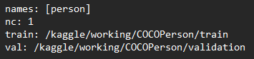



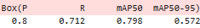

Slide 11


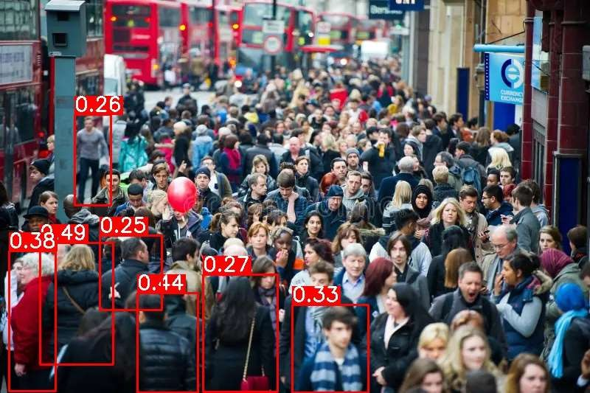
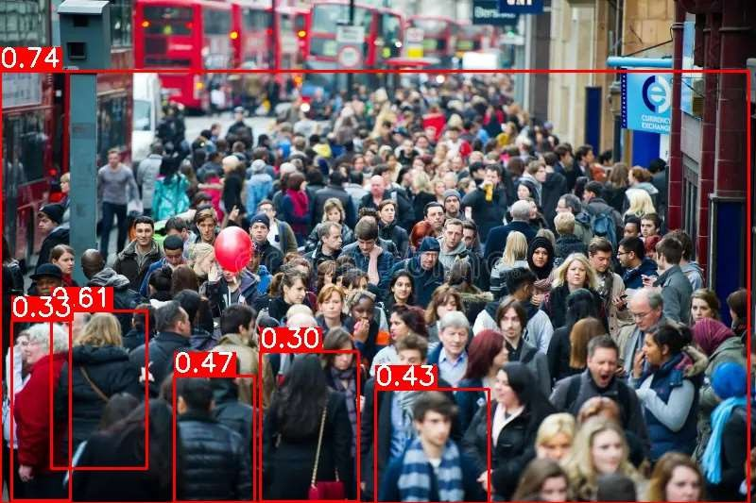
Pretrain YOLOv8m No Train
Pretrain YOLOv8m with Train

Slide 12

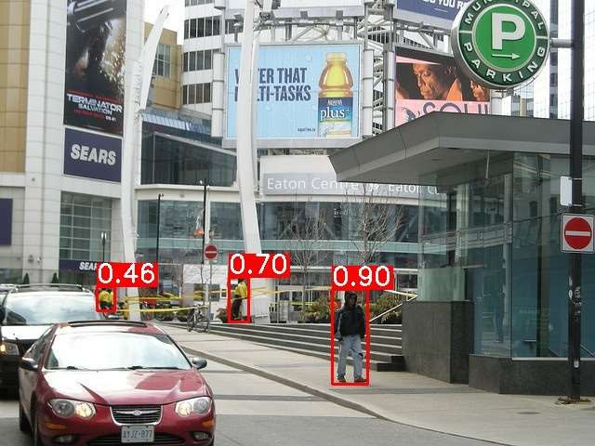
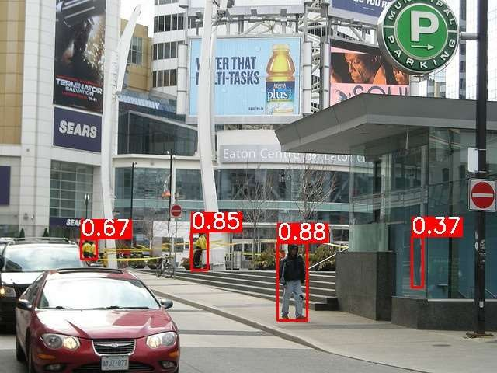
Pretrain YOLOv8m No Train
Pretrain YOLOv8m with Train

Slide 13

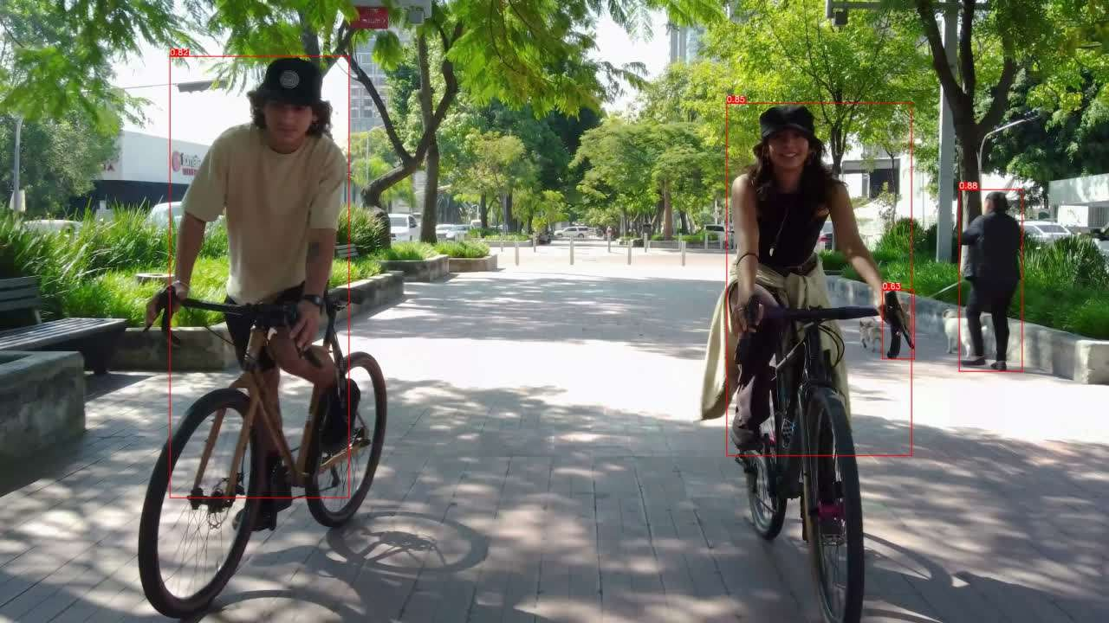

Pretrain YOLOv8m No Train
Pretrain YOLOv8m with Train

Slide 14

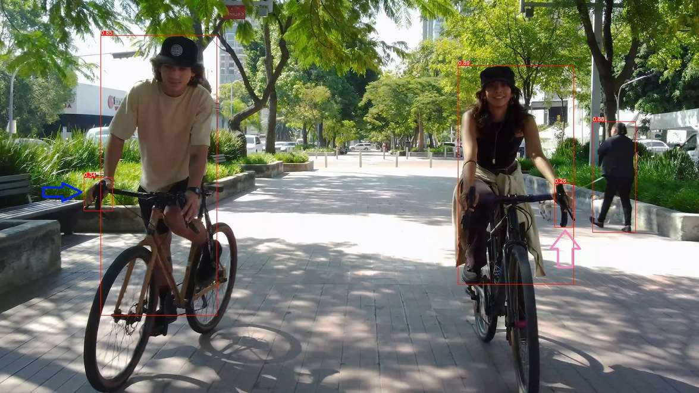
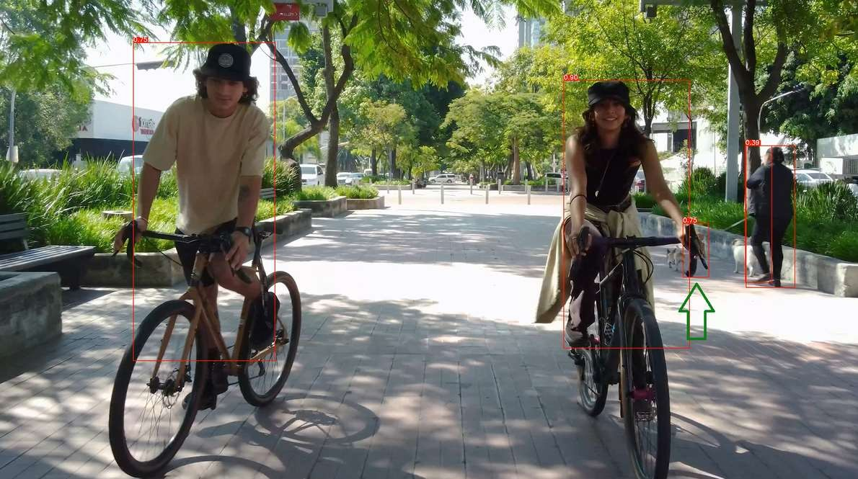
Pretrain YOLOv8m No Train
Pretrain YOLOv8m with Train

Slide 15


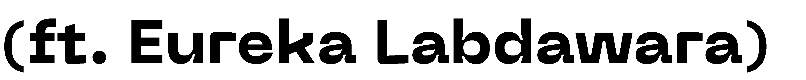


Slide 16

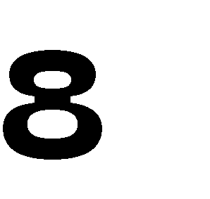



Slide 17


















•
•

Slide 18
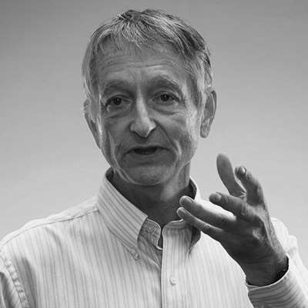


Thank You
CV-D (Geoffrey Hinton)
NAMA ANGGOTA | PENUGASAN
Calvin Christian Chandra (Team Leader) | Coding, pembuatan PPT
Satrio Fatturahman | Coding, pembuatan PPT
Shania Salsabilla | Coding, pembuatan PPT
Eureka Labdawara | Coding, pembuatan PPT
Alamul Yaqin | Coding, pembuatan PPT
The brain sure as hell doesn't work by somebody programming in rules.
GEOFFREY HINTON

